Slide 1
BIOMETRIC FACE RECOGNITION SECURITY SYSTEM
VISHAL CHANDRU 211616115057
SUPERVISOR: LEANDO I
(ASSISTANT PROFESSOR)

Slide 2
ABSTRACT
We present an approach to secure homes using facial recognition technology combined with the existing locking mechanism to improve the security with the motive of cost efficiency. Our approach uses sub-machine vector to identify the face and capture a two-dimensional image by taking specific points on the face and comparing it with the stored images.

Slide 3
INTRODUCTION
As the need for security is growing everyday, facial recognition has slowly become the most secure mode of protection from threats.
Face recognition is an advanced technology that uses deep learning or machine learning techniques to identify a person using their facial features
It is the most secure biometric system present
It became a huge success by implementing the technology in the smartphone industry
We have implemented the facial recognition technology in unlocking doors

Slide 4
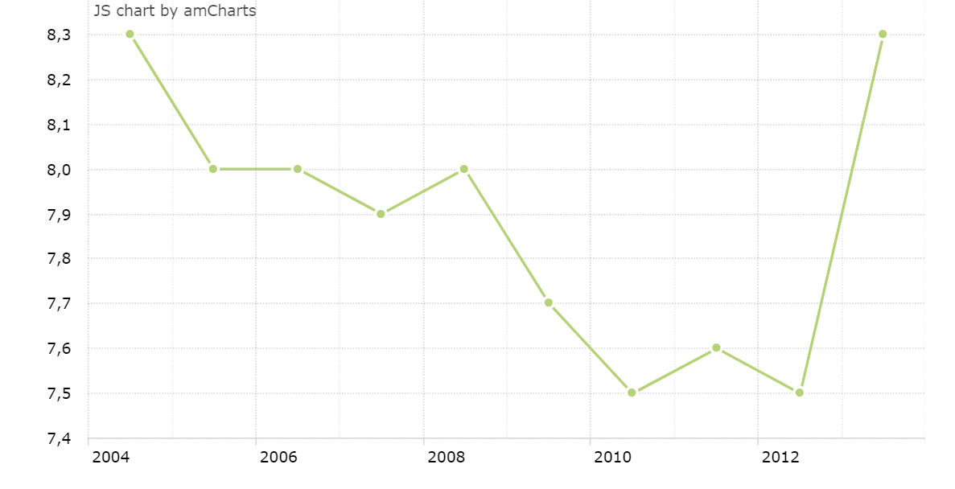
India burglary report per 1,00,000 population
SOURCE: TIMES OF INDIA July 12 2018

Slide 5
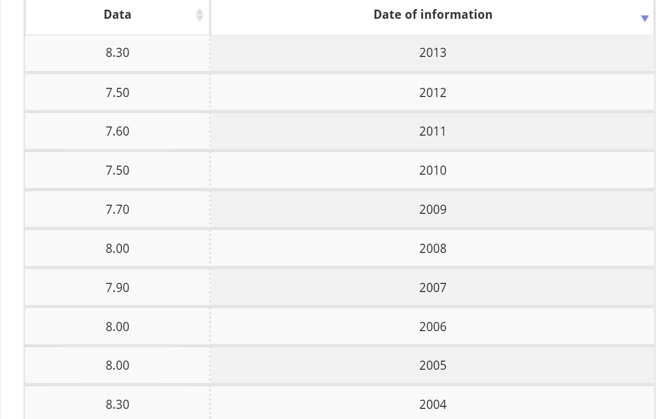
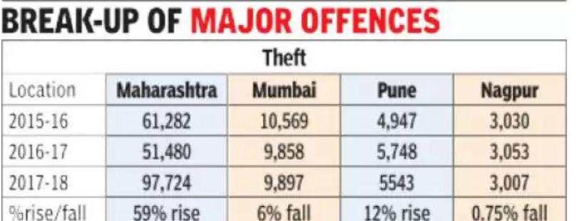
Average rate of burglary
SOURCE: TIMES OF INDIA July 12 2018

Slide 6
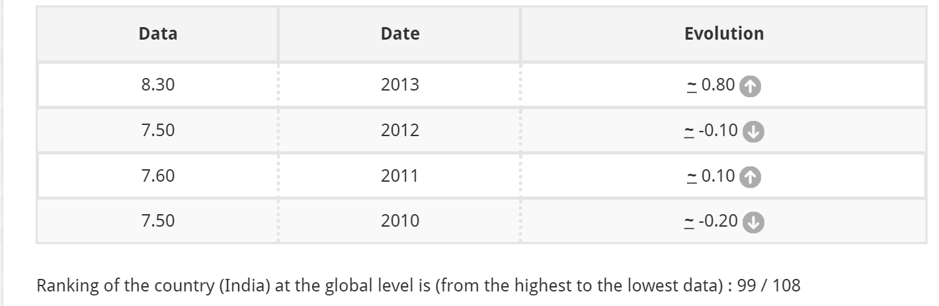
Growth in burglary per 1,00,000 population
SOURCE: TIMES OF INDIA July 12 2018

Slide 7
Literature survey
Sl.No | YEAR | AUTHOR | TITLE | INFERENCE
1 | 2017 | Siddhi Kavade, Riddhi Kavade | Smart digital door lock system using Bluetooth technology | The owner can unlock the door using IOT and can also view the live stream
2 | 2015 | JF Buzhardt | Smart door lock | A self-contained door locking apparatus is disclosed which collects, stores, displays, and/or transmits information each time the apparatus is opened, closed, or even merely handled.
3 | 2015 | Omkar M. Parkhi | Deep Face Recognition | Convolutional Neural Networks has been used to detect the face

Slide 8
Sl.No. | YEAR | AUTHOR | TITLE | INFERENCE
4 | 2013 | Manasee Patil, S.R.N. Reddy | Comparative Analysis of RFID and Wireless Home/Office Automation | RFID card is used to the unlock door and is used as a source to power the house
5 | 2009 | Yong Tae Park, Pranesh Sthapit | Smart digital door lock for home automation | Door that unlocks after an RFID tag authentication
6 | 2005 | Shuicheng Yan Yuxiao Hu Hong-Jiang Zhang Partha Niyogi Xiaofei He | Face Recognition Using Laplacianfaces | An appearance-based face recognition method called the Laplacian face approach

Slide 9
Sl.No. | YEAR | AUTHOR | TITLE | INFERENCE
7 | 2004 | Timo Ahonen Abdenour Hadid Matti Pietikäinen | Face Recognition with Local Binary Patterns | A novel approach to face recognition which considers both shape and texture information to represent face images.
8 | 2000 | C.Doucet | Electronically activated door lock | An electronic card reader is used to unlock the door
9 | 1999 | Mathew A. Turk, Alex P. Pentland | Face Recognition using Eigenfaces | The concept of eigenface has been implemented for facial recognition

Slide 10
Sl.No. | YEAR | AUTHOR | TITLE | INFERENCE
9 | 1997 | Jean-Marc Fellous Norbert Krüger Christoph von der Malsburg Laurenz Wiskott | Face recognition by elastic bunch graph matching | A system for recognizing human faces from single images out of a large database with one image per person.
11 | 1990 | KW Gartner, AK Uyeda | Electronic door lock | The door locking bolt being accomplished after entry of the predetermined code
12 | 1962 | E. J. LEONARD | Multi-digit electrical door lock | In this project a multi digit locking number is used to unlock the door

Slide 11
RESEARCH GAP
From the above literature surveys we can infer that neither smart door lock system nor facial recognition have been incorporated with each other using deep learning
In our project we have incorporated both these technologies together using deep learning and facial recognition techniques.
Using deep learning the accuracy is significantly increased and thus security is enhanced.

Slide 12
CONCEPTUAL DESIGN
MATERIALS:
FABRICATION
Plywood (3*2.5 Feet)
Nails (3\4 inch)
Nut and Bolts
Hinge 2 pieces
Gear
Rack
U – Clamps (3 pieces)
DESIGN SOFTWARE:
AUTOCAD

Slide 13
ELECTRICAL COMPONENETS:
Servo Motor: | Model: MG995
 | Weight: 55 gm
 | Operating voltage: 4.8V~ 7.2V
 | Servo Plug: JR
 | Stall torque @4.8V : 10 kg-cm
 | Stall torque @6.6V : 12 kg-cm
Arduino Uno R3: | Microcontroller: ATmega328
 | Operating Voltage: 5V
 | Input Voltage (recommended): 7-12V
 | Clock Speed: 16 MHz
 | DC Current per I/O Pin: 40 mA
Power Distribution Board Version 2: | Input voltage: 12v

Slide 14
OTHER COMPONENTS:
CIRCUIT: Arduino UNO R3
Servo motor
Power Distribution Board
Jumper Wires
SOFTWARE: Python 3.7 IDE
IP Webcam App
Arduino

Slide 15
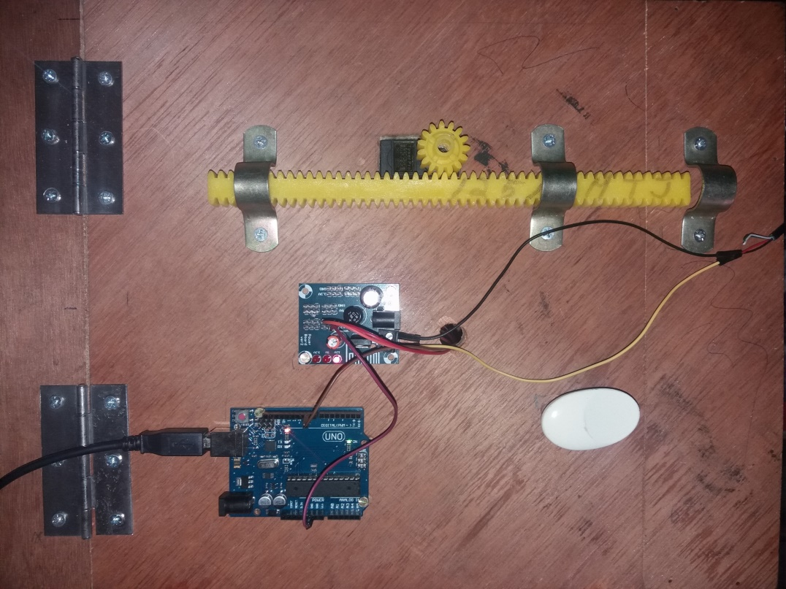
COMPONENTS
SERVO MOTOR
RACK
PINION
HINGES
CLAMP
POWER DISTRIBUTION BOARD
POWER CORD
INTERFACED TO PC
ARDUINO UNO
KNOB

Slide 16
methods
The System uses an IPWebcam App which gives access to the phones camera by creating a URL for the camera , to capture a frame of a video to do the processing.
Initially, when the central computer system connects to the IP camera’s URL , frames are captured by the camera and transmitted to the laptop, where the frame is processed by the Deep Neural Network for the analysis of the face detection and face recognition.
The frame is first quantified by the use of extractedembeddings.py folder, where first the face is detected from the image by a FACENET module, and 64 points of the face is detected (left eye, right eye, left eyebrow, right eyebrow,nose, and mouth) where it is converted into 128 d embeddings.
These embedding are the quantified image, which is further sent for the processing.
The module of the owners face is first trained and saved in a dataset to the central computer system , by the use of traindataset.py where the system already has a quantified image of the owners face.

Slide 17
The quantified image of the face captured by the IP camera is compared with the quantified image in the module trained by the dataset.
If there is a match , the signal is sent to the Arduino to power the servo motor which, results in turning the gear in clockwise direction and the rack moves backwards unlocking the door.
It remains unlocked as long as the owner prompts the door to close.
Once the door is closed, the cycle repeats.

Slide 18
Mechanical design

Slide 19
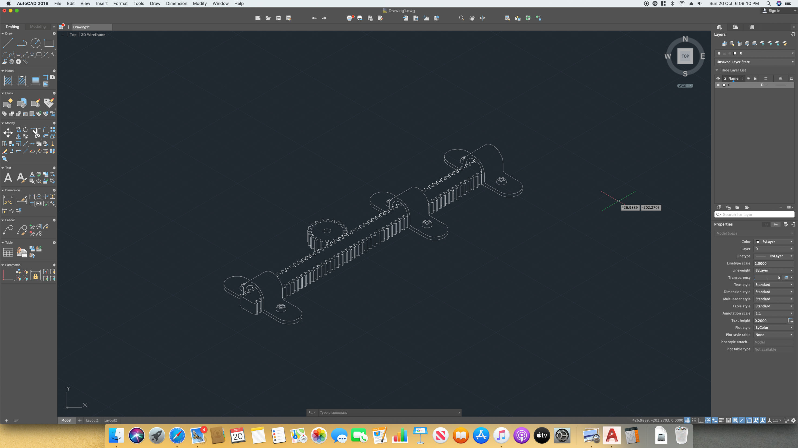

Slide 20
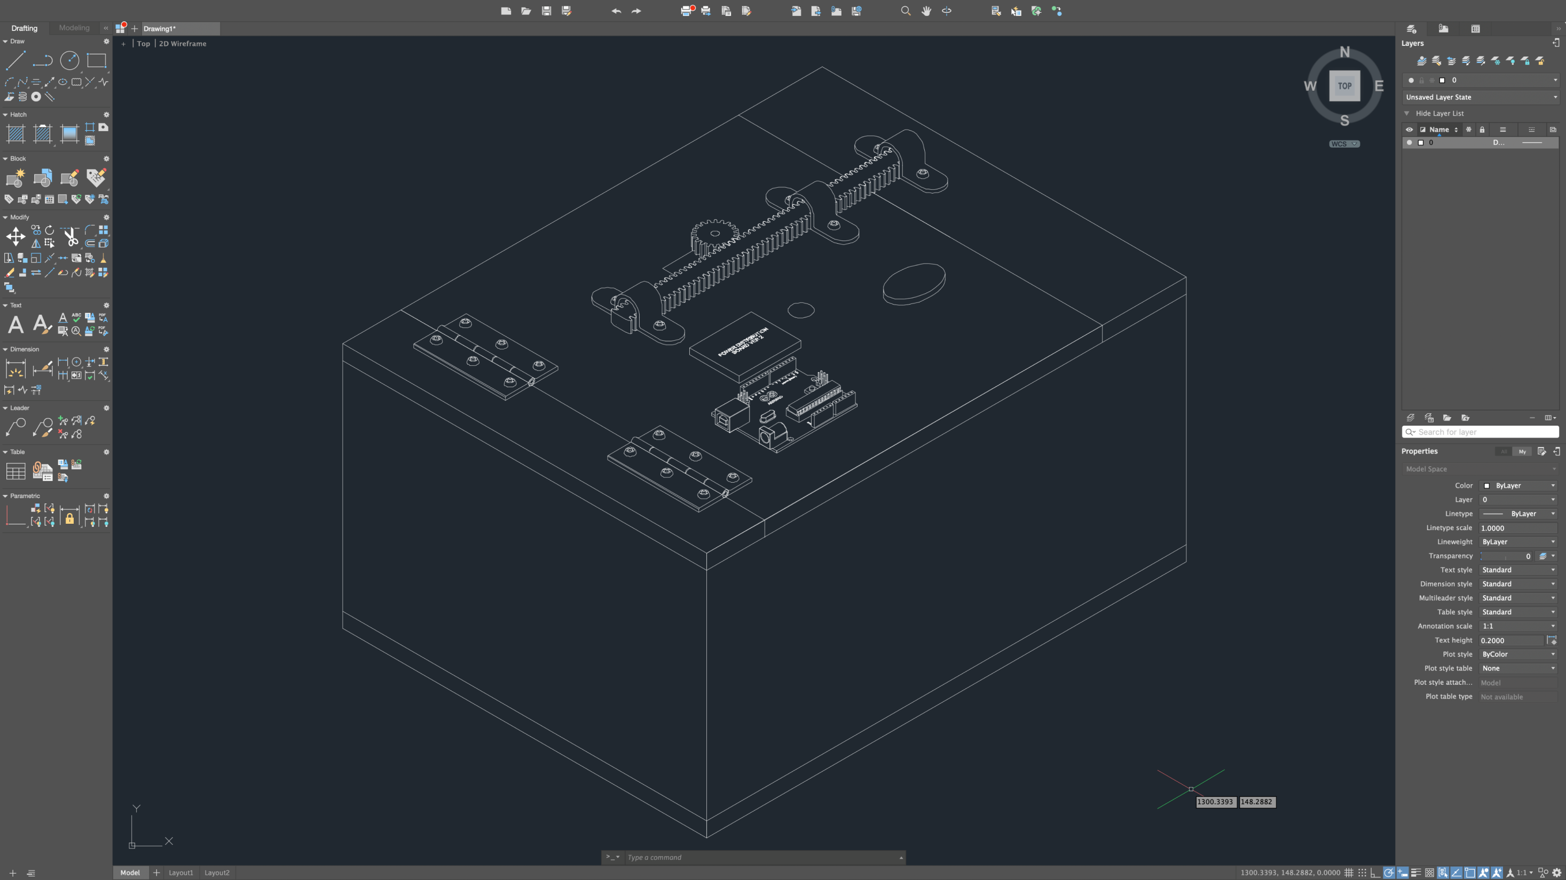

Slide 21
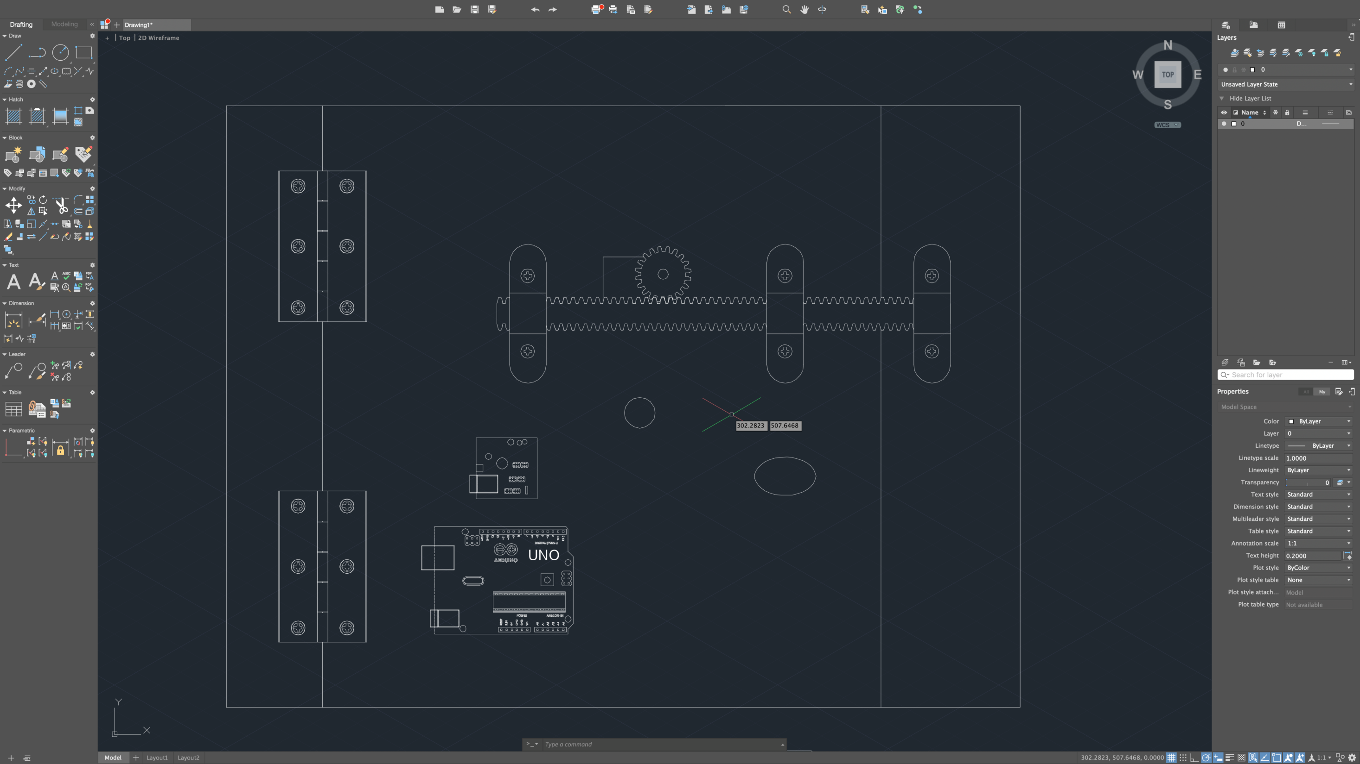

Slide 22
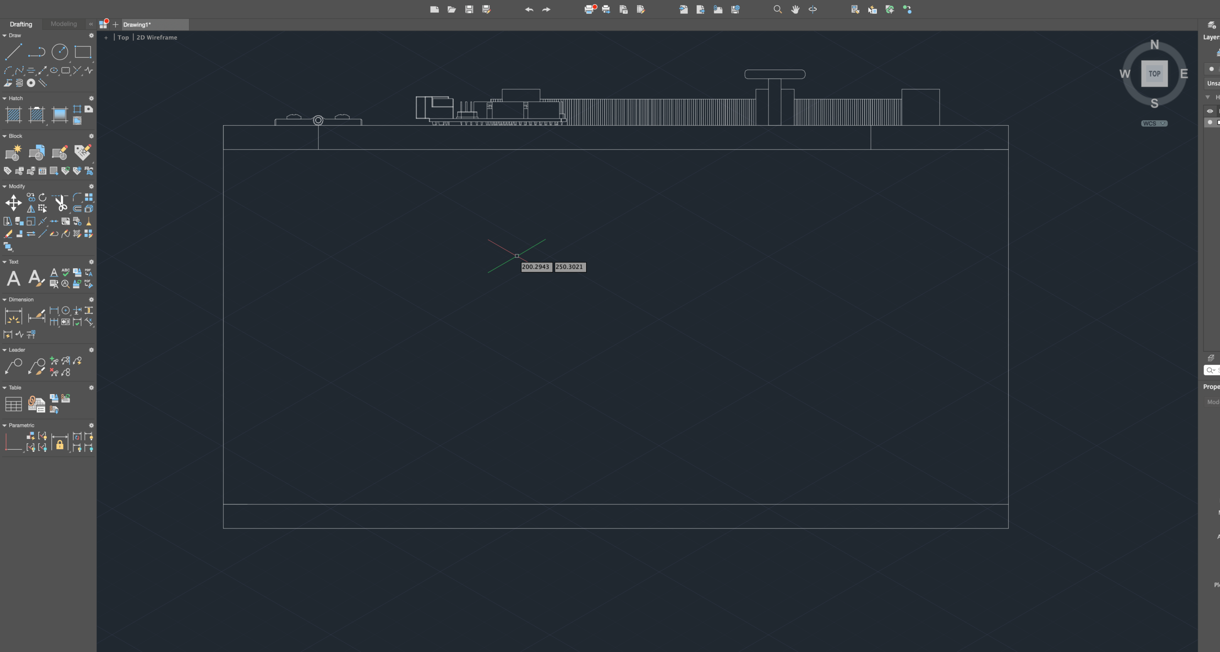

Slide 23
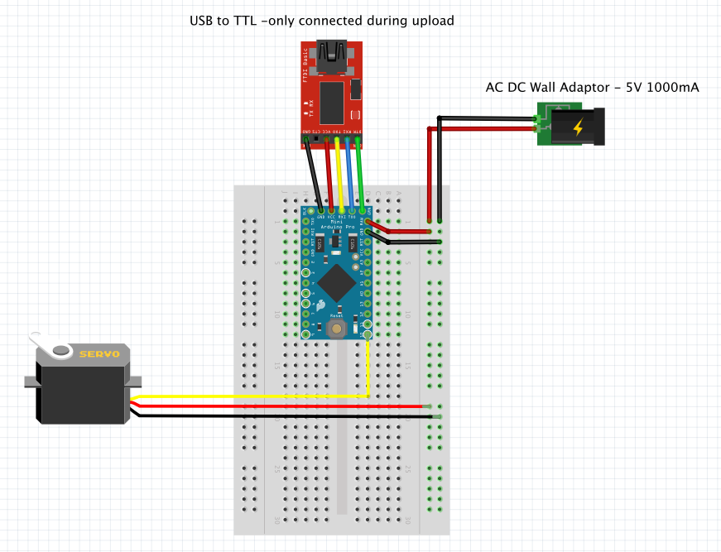
Electrical design

Slide 24
DETAILED DESIGN
DETECTION OF FACE
FLOW CHART
CAPTURE IMAGE
COMPARE IMAGE
UNLOCKS
REMAINS LOCKED
MATCHED
UNMATCHED

Slide 25
Design CALCULATION
RACK AND PINION :
Rack length = 22.8cm
No. of teeth on rack = 50
Pinion diameter = 1.8cm
No. of teeth on pinion = 15
GEAR RATIO = No. of teeth on driver gear/No. of teeth on rack
= 15/50 = 3:10 = 0.3
RACK DISPLACEMENT PER 360 DEGREE ROTATION = Gear ratio * Length of the rack
= 0.3 * 22.8
= 6.84 cm
= 3.42 cm per 180 degree rotation

Slide 26
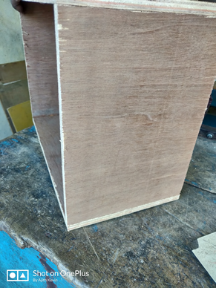
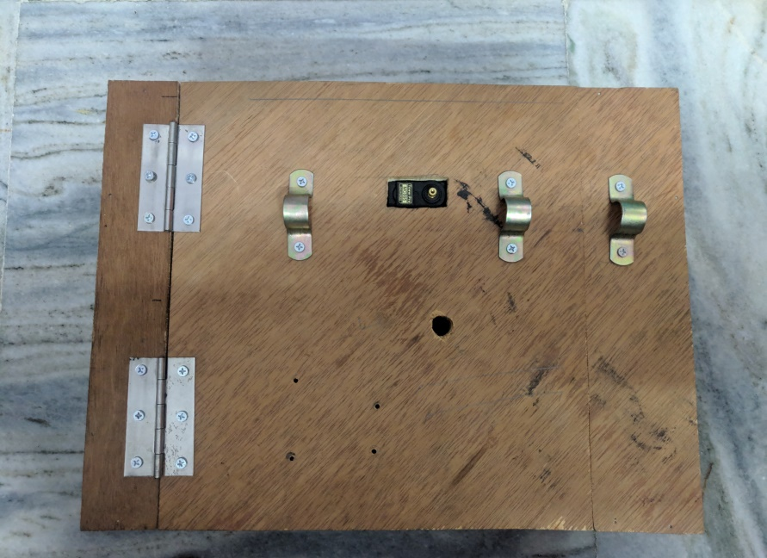
GALLERY

Slide 27
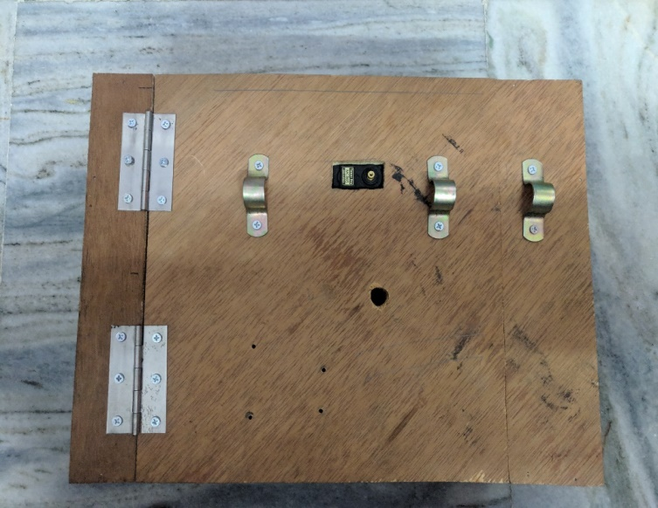
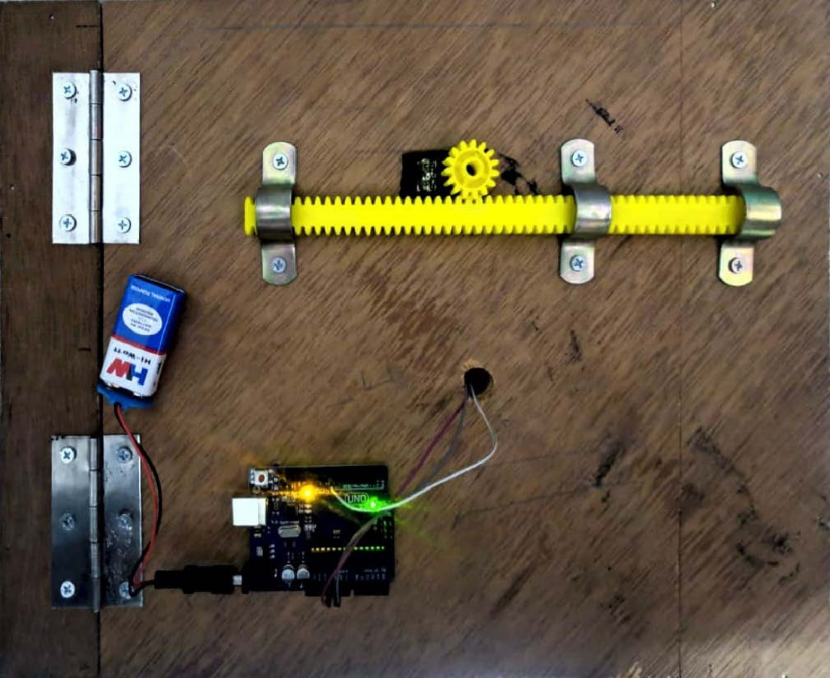
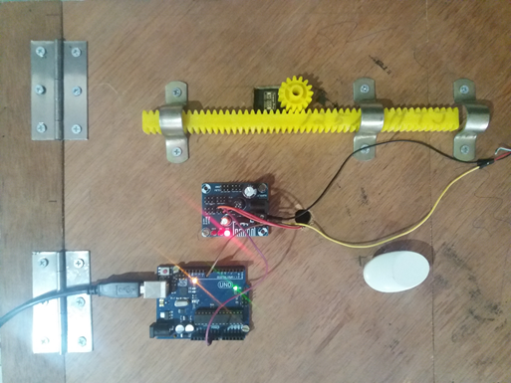

Slide 28
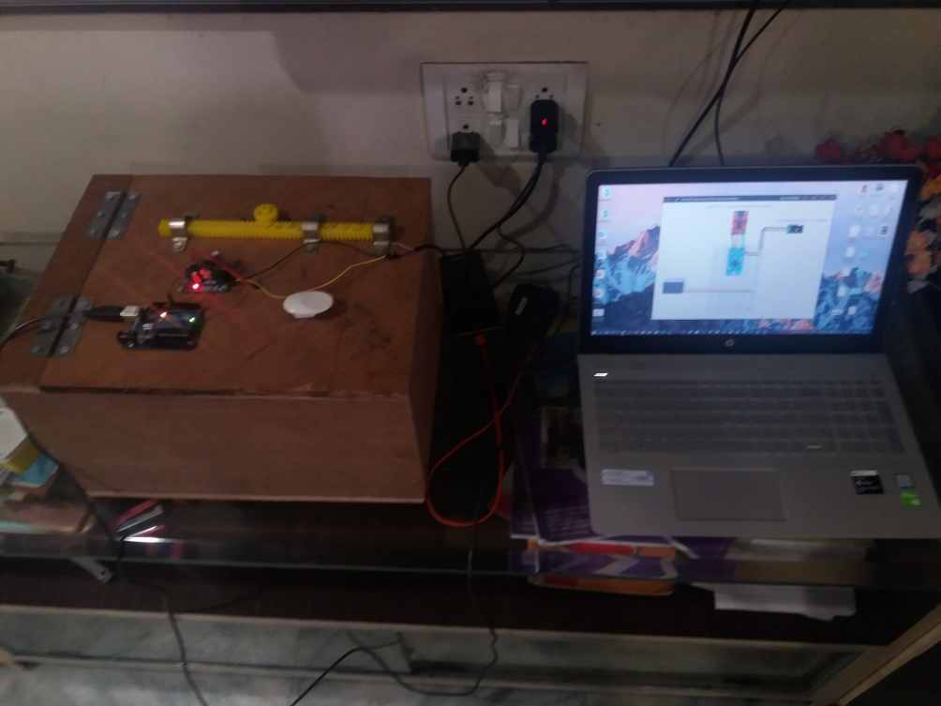
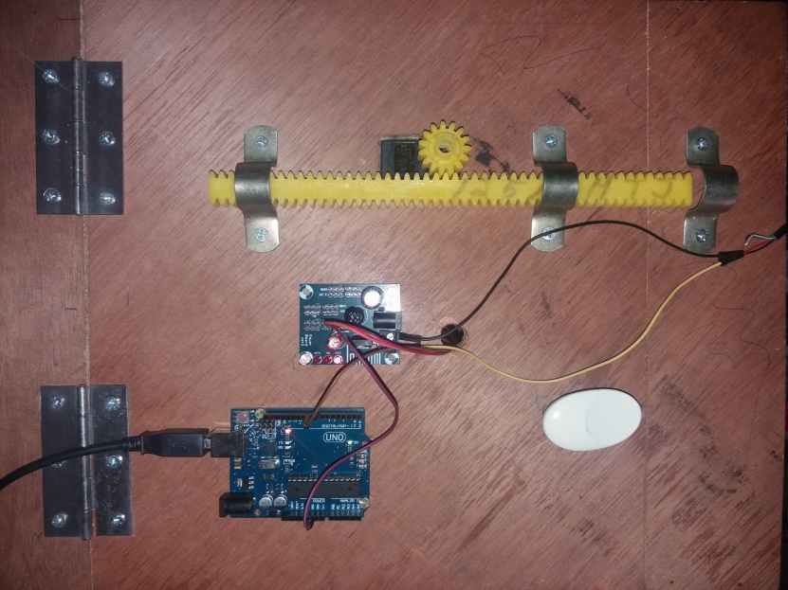
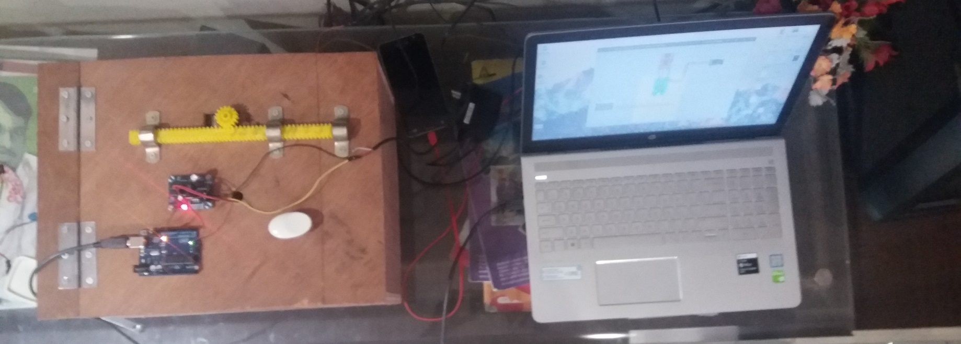

Slide 29
Result
Prototype of the safe works as it was expected and successfully detects the owners face with the implementation of software code and opens the mechanical latch, designed with precision to increase the security of the system and closes only when prompted by the owner.
The motive of the project is achieved by this simple prototype with the objective of improving the security and safeguard the properties of the owner from theft and burglary.

Slide 30
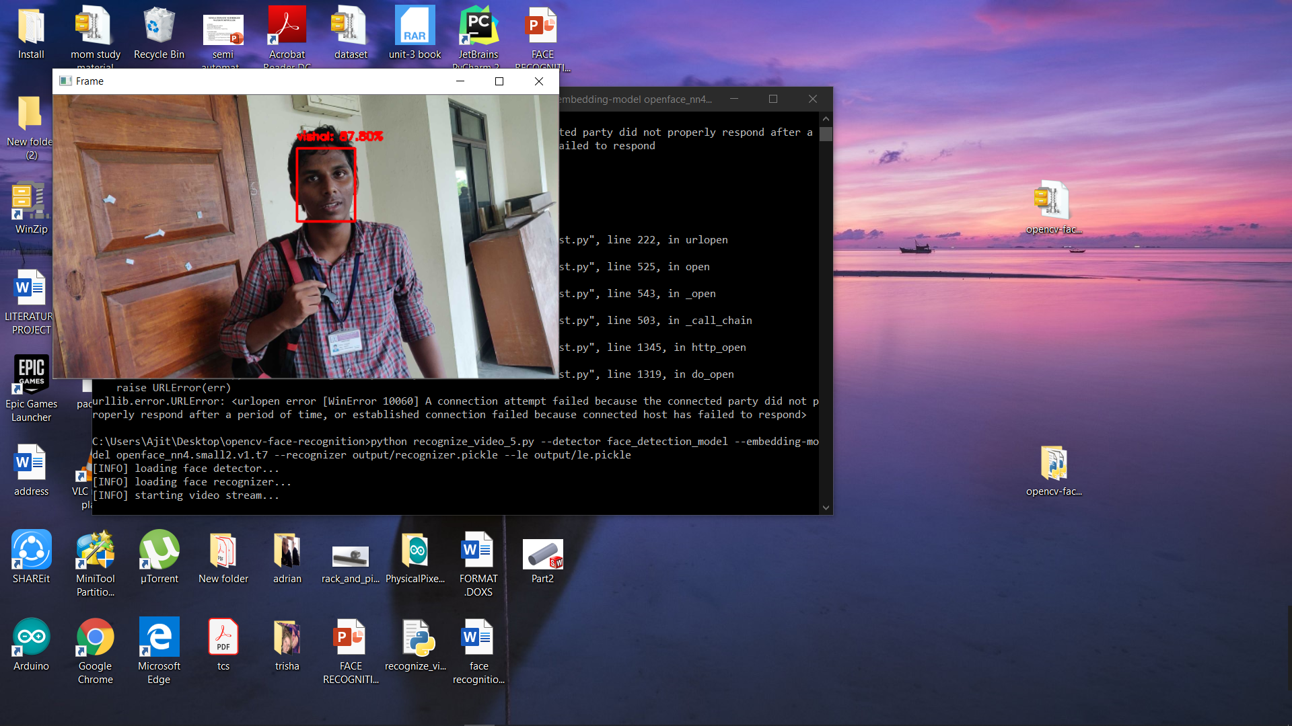
Before creating a embedding of the image, a face detection model detects the face and crops the face from the input images.
As in real-time the faces may not always be [perfectly aligned with the camera, so affine transform from opencv is used to align the image .

Slide 31
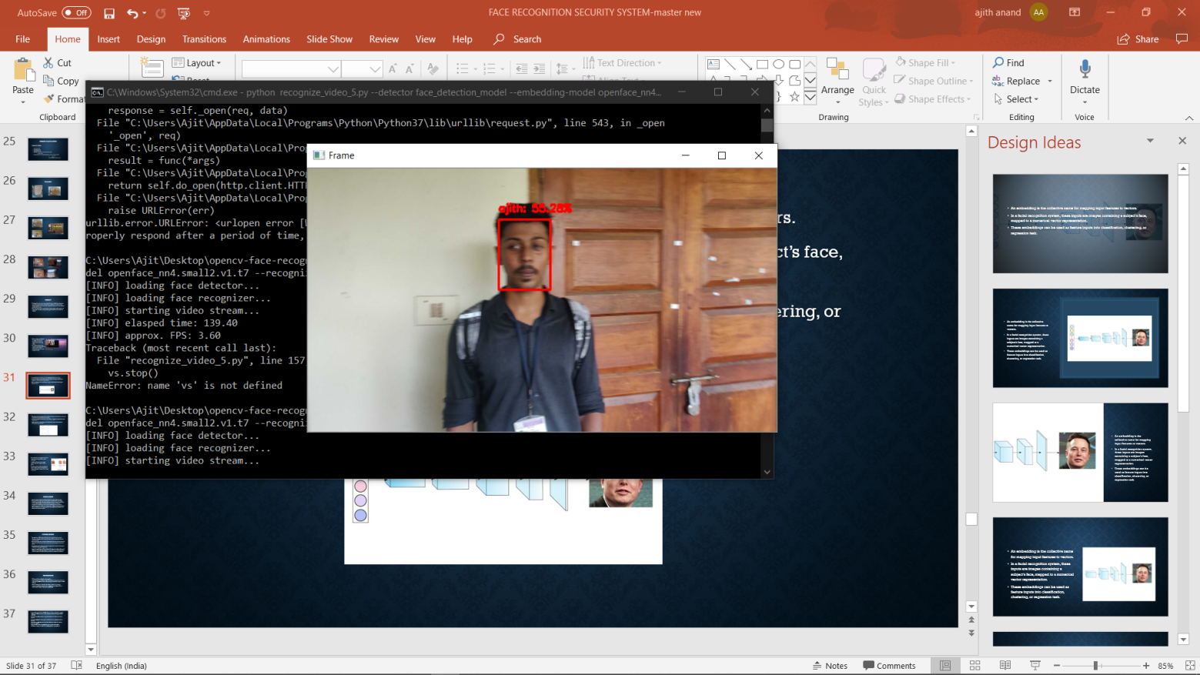
An embedding is the collective name for mapping input features to vectors.
In a facial recognition system, these inputs are images containing a subject’s face, mapped to a numerical vector representation.
These embeddings can be used as feature inputs into classification, clustering, or regression task.

Slide 32
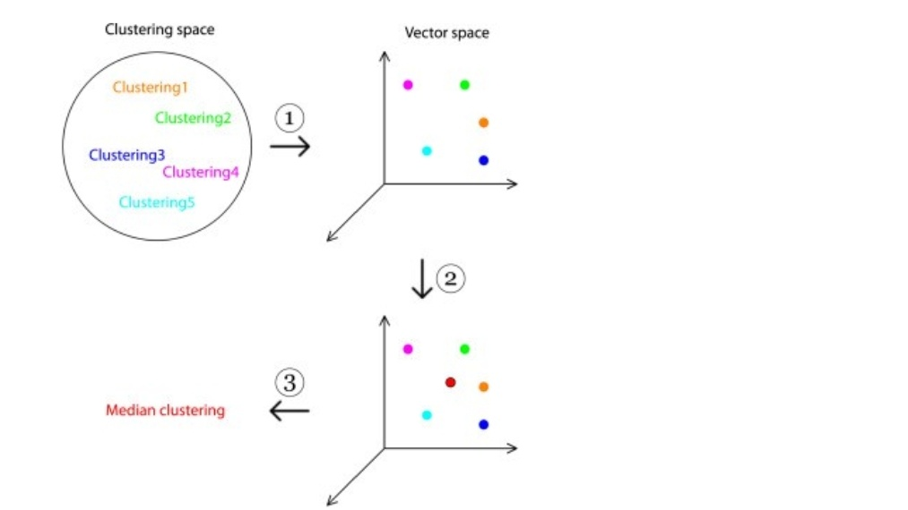
Since these vectors are represented in shared vector space, vector distance can be used to calculate the similarity between two vectors.
In a facial recognition context, this can vector distance applied to calculate how similar two faces are.
Additionally, these embeddings can be used as feature inputs into classification, clustering, or regression task.

Slide 33
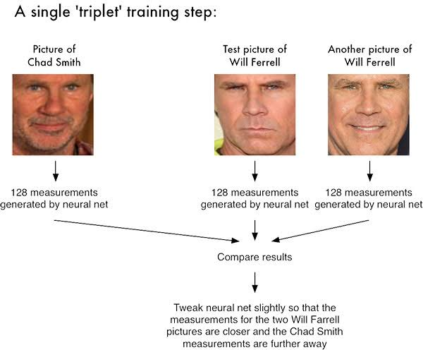
The model also uses a triplet loss function to make more accurate predictions of the trained face.
In triplet loss function a base image, a postive image and a negative image is given.
The distance between the base image and positive image is reduced and the distance between the negative image and base image is increased.

Slide 34
CONCLUSION
We have designed and fabricated the prototype of our project (Biometric Face Recognition Security System) and we are here to conclude that the methodology used in this project helps to the further development of the existing security systems in various fields. Though we made the design as a prototype, in our view it strengthens the disadvantages in the ancient methodology and converted to an ergonomical product as it does not normally involve any physical locking mechanism rather the whole process is happening in the central computer system which no one other than the owner has access to.

Slide 35
FUTURE SCOPE
The application of IOT which enables the owner to control the system over the Internet can be implemented to access the camera of the security system from any side of the world.
By incorporating the latest solenoid enabled lock other than the mechanical rack and pinion can ensure the system works at any situation, by reducing the error of servos system.
Using Raspberry Pi can help in faster processing of the face and increase the speed of detection and recognition of the face.
Instead of using a 64 points 128 embeddings of the face, we can implement the use of 208 points embeddings which captures the image at 3D format and quantifying them enables the system to identify the difference between an image and a real person.

Slide 36
REFERENCES
M. Turk and A. Pentland. Eigenfaces for recognition.
L. Wiskott, J.-M. Fellous, N. Krüger and C.v.d. Malsburg. Face recognition by elastic bunch graph matching. IEEE Transactions on Pattern Analysis and Machine Intelligence, 19:775-779, 1997
G. Heusch, Y. Rodriguez, and S. Marcel. Local Binary Patterns as an Image Preprocessing for Face Authentication. In IEEE International Conference on Automatic Face and Gesture Recognition (AFGR), 2006.

Slide 37
Bengio, Y.; Courville, A.; Vincent, P. (2013). "Representation Learning: A Review and New Perspectives". IEEE Transactions on Pattern Analysis and Machine Intelligence. 35 (8): 1798–1828
Schmidhuber, J. (2015). "Deep Learning in Neural Networks: An Overview". Neural Networks
Bishop, C. M. (2006) Pattern Recognition and Machine Learning. Chapter 5: Neural Networks. Schmidhuber, J. (2015). Deep Learning in Neural Networks: An Overview : Neural Networks 61: 85-117. Bengio, Y., LeCun, Y., Hinton, G. (2015). Deep Learning. Nature 521: 436-44. Goodfellow, I., Bengio, Y. and Courville, A. (2016) Deep Learning. MIT Press.

